Slide 1
COMP4448 Final Project
Megan Hoeksema
Nov 14, 2022

Slide 2
Research question and Purpose
Project Purpose:
To understand the performance of Decision Trees, Random Forest, KNN and Naïve Bayes in predicting whether someone is a smoker or not based on various factors.
Research Question:
Of the following algorithms, KNN, Decision Trees, Random Forest and Naïve Bayes, which will produce a better model for predicting the smoking status of indoor workers based on race, gender, age, education and workplace smoking bans?

Slide 3
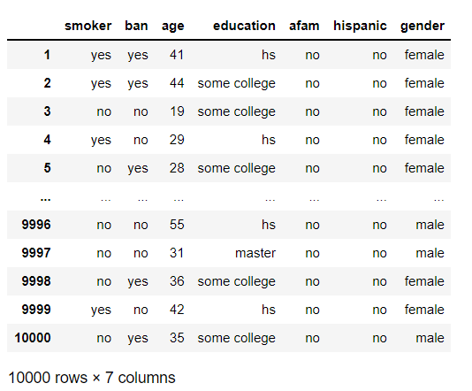
Dataset/Description of variables
https://vincentarelbundock.github.io/Rdatasets/doc/AER/SmokeBan.html
Set of 10,000 observations of 7 variables conducted on indoor workers.
Collected as part of the National Health Interview Survey conducted in 1991 and 1993.
Used to estimate the effect of workplace smoking bans.
The following input variables are included:
Ban – yes, no
Age – an integer
Highest level of Education – HS drop out, HS, some college, college, masters
African American – yes, no
Hispanic – yes, no
Gender – male, female
The following variable will be used as output:
Smoker – yes, no

Slide 4
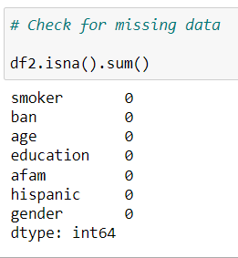
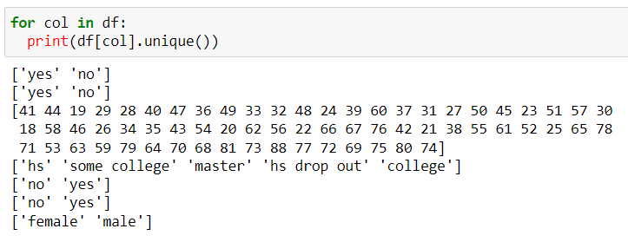
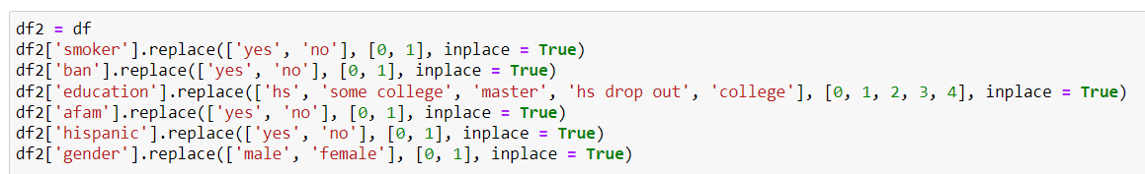
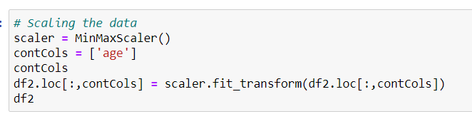
Data preprocessing
Check for unique variables:
Allows to see if any categorical columns have overlapping values (spelled differently, capitalization, spacing)
Check numerical values (Age) to verify that the numbers make sense.
Check for missing values
Convert categorical variables (ban, education, AFam, Hispanic and gender) to numerical ones.
Then scaled the numerical variables (age) using MinMaxScaler.

Slide 5
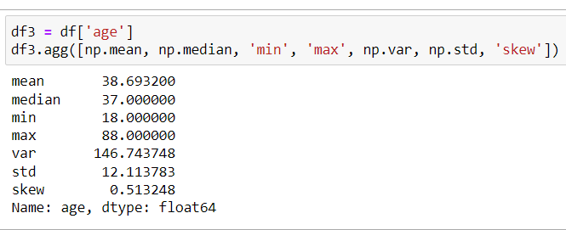
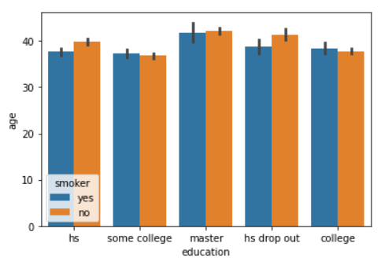
Data Exploration
Descriptive statistics for numerical variables
Average age per education status and smoking status

Slide 6
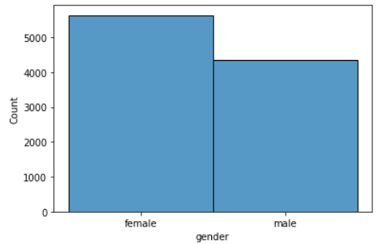
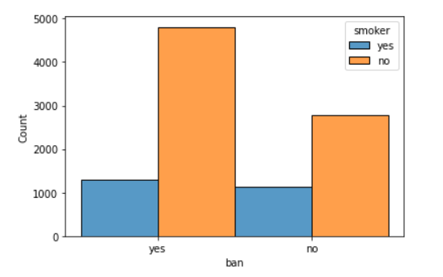
Data Exploration
Visualization of the number of men vs the number of women in the dataset.
Visualization of the number of smokers and nonsmokers per ban category.

Slide 7
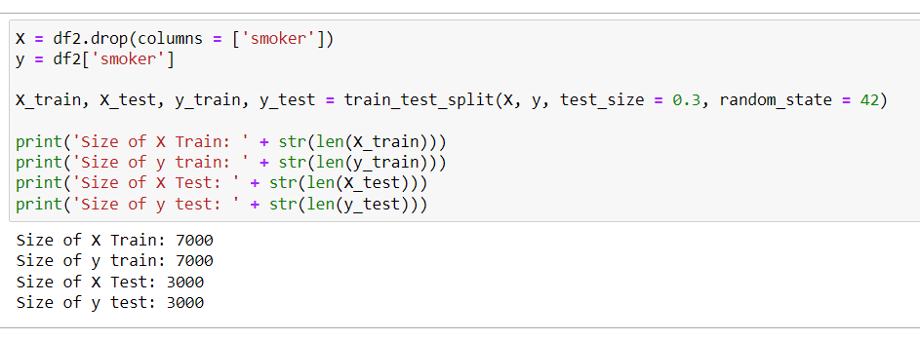
Data splitting
Used train_test_split from sklearn.model_selection to split the data 70/30.

Slide 8
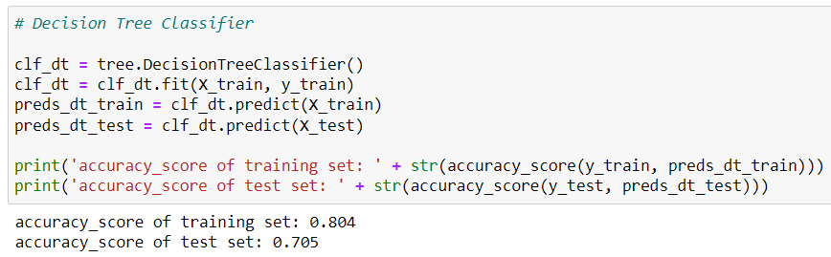
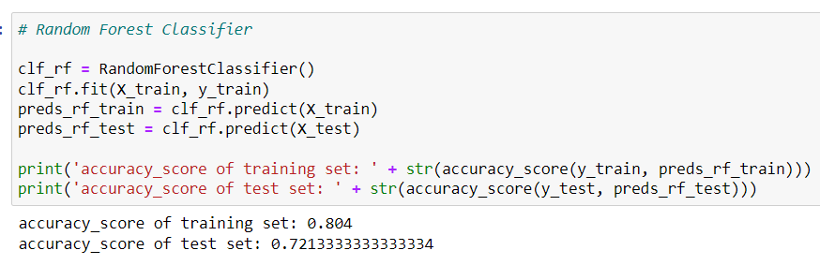
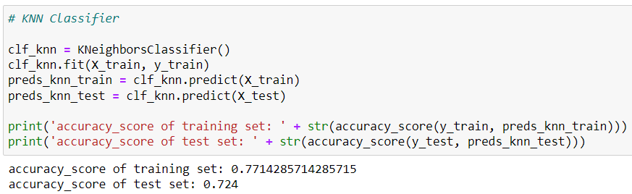
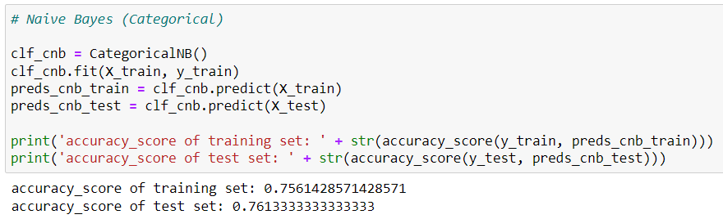
Model Construction
Constructed four classification models: Decision Tree, Random Forest, KNN, and Naïve Bayes
Based on the accuracy of the training set, both Decision Tree and Random Forest perform equally well, with KNN and Naïve Bayes slightly less accurate. However, when looking at the accuracy scores for the test set, Naïve Bayes outperforms all other models.

Slide 9
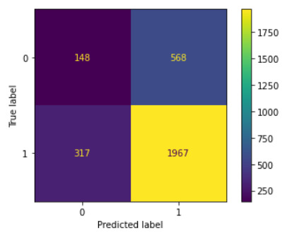
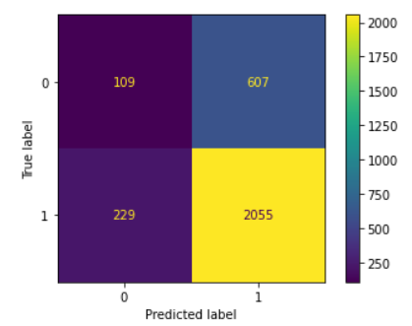
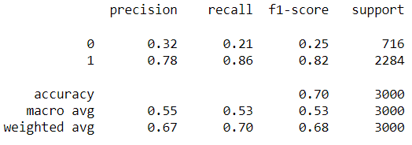
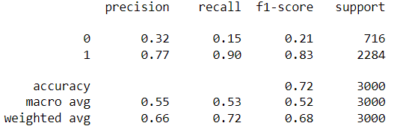
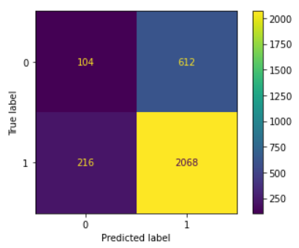
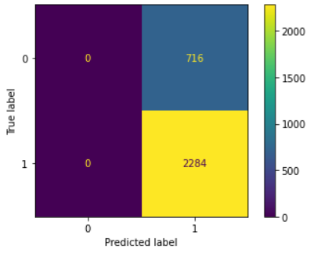
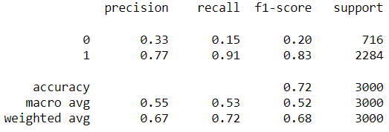
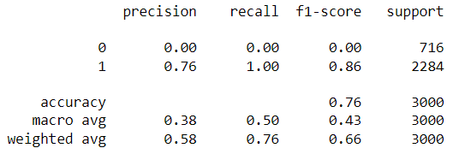
Model Evaluation
To further evaluate the classification models, a classification report and confusion matrix were generated for each model.
Decision Tree
Random Forest
KNN
Naïve Bayes

Slide 10
Model tuning
Decision Trees:
Tuned max_depth and max_features, criterion
Best Estimator: max_depth = 4, max_features = 0.8, criterion = entropy
Improved the accuracy of test from 0.705 to 0.76
Random Forest:
Tuned max_depth, max_features, n_estimators
Best Estimator: max_depth = 7, max_features = 0.8, n_estimators = 30
Improved the accuracy of test from 0.72 to 0.77
KNN:
Only one parameter to tune, n_neighbors
Best Estimator: n_neighbors = 39
Improved the accuracy of test from 0.724 to 0.76
Naïve Bayes:
Tuned alpha, fit_prior, and min_categories
Best Estimator: alpha = 0.01, fit_prior = True, min_categories = 18
Tuning did not improve nor decrease the accuracy of test. It remained at 0.76

Slide 11
Conclusion
Data Exploration:
No missing values, dataset is complete
Median age is 37
Based on the graphical representation of gender per education group and smoking status is between 35-45 for each group.
More women participated in this data collection than men.
Based on graphical representation of the number of smokers per ban category, the number of nonsmokers is much higher in workplaces that have a ban than those that do not have a ban.
Model Construction:
Based on the accuracy of the training sets, both Decision Tree and Random Forest perform equally well, with KNN and Naïve Bayes slightly less accurate.
When comparing the accuracy scores for the test set, Naïve Bayes outperforms all other models.
Model Tuning:
Tuned various parameters for each of the models.
Tuning Naïve Bayes did not increase the accuracy score.
After tuning the other three models, the accuracy of Decision Tree and KNN rose to 0.76.
Random Forest appeared to perform the best (slightly) with an accuracy score of 0.77 after tuning parameters.

